Slide 1
NOS
DutyRoster
PLAN
ASSIGN
Nurse rosters, digital unit assignments and approvals
APPROVE
A visual guide for Unit Managers, Hospital Managers, Supervisors and staff
REPORT
V43 tutorial
Notes:
[Sources]
- DutyRoster V43 application interface and project source (internal, accessed 2026-09-04)
[/Sources]

Slide 2
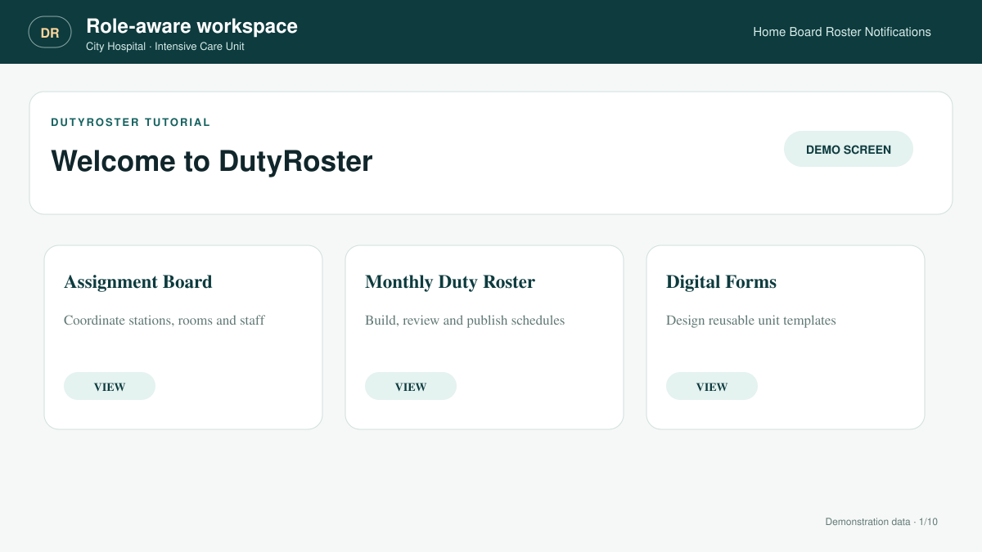
DUTYROSTER
02
ACCOUNTS AND UNITS
Start with role-aware access
Each person enters the workspace assigned to their hospital role and active unit.
Unit staff see execution tools
Managers control templates and rosters
Trial and subscriptions are licensed per unit
Notes:
[Sources]
- DutyRoster V43 application interface and project source (internal, accessed 2026-09-04)
[/Sources]

Slide 3
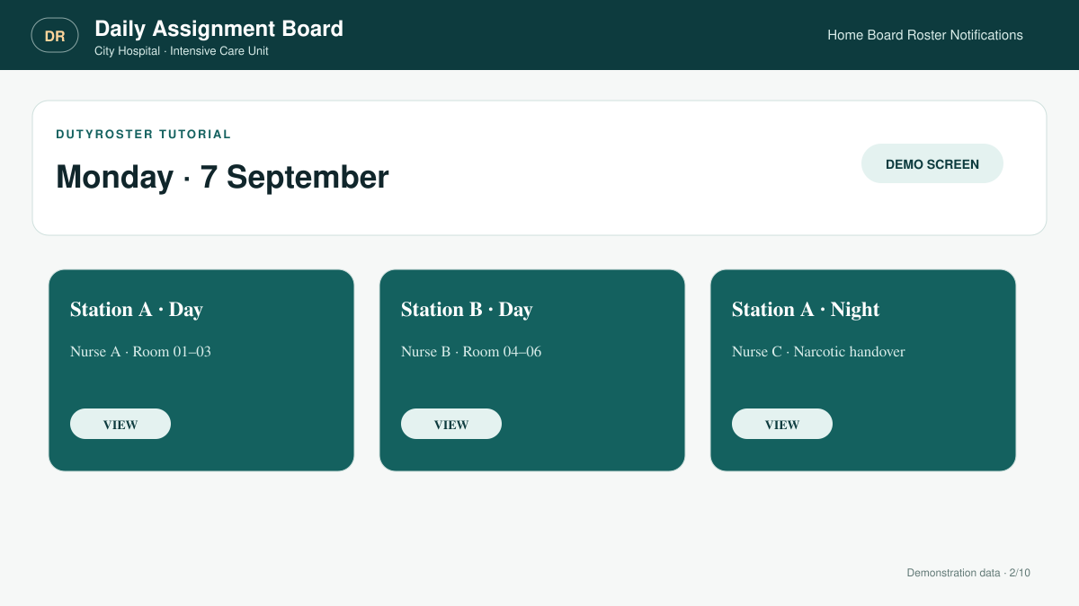
DUTYROSTER
03
OPERATIONAL VIEW
Run the daily assignment board
Keep station staffing, shifts, rooms and unit duties visible from one daily board.
Registered or manual staff
Unit-scoped assignments only
Digital form names open the execution form
Notes:
[Sources]
- DutyRoster V43 application interface and project source (internal, accessed 2026-09-04)
[/Sources]

Slide 4
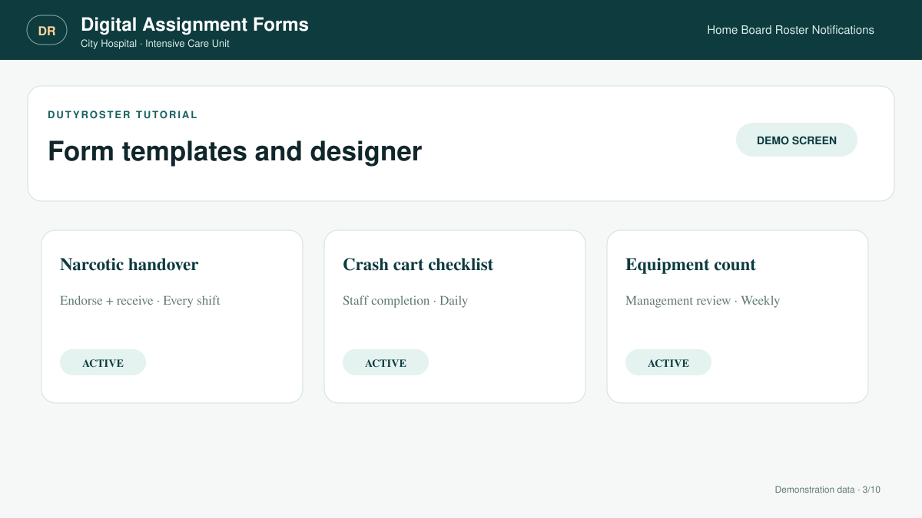
DUTYROSTER
04
DIGITAL ASSIGNMENT FORMS
Build unit form templates
The Digital Forms module now focuses on reusable templates and the form designer.
Separate templates for every unit
Restore a reusable ICU-style package
Activate, revise or archive official forms
Notes:
[Sources]
- DutyRoster V43 application interface and project source (internal, accessed 2026-09-04)
[/Sources]

Slide 5
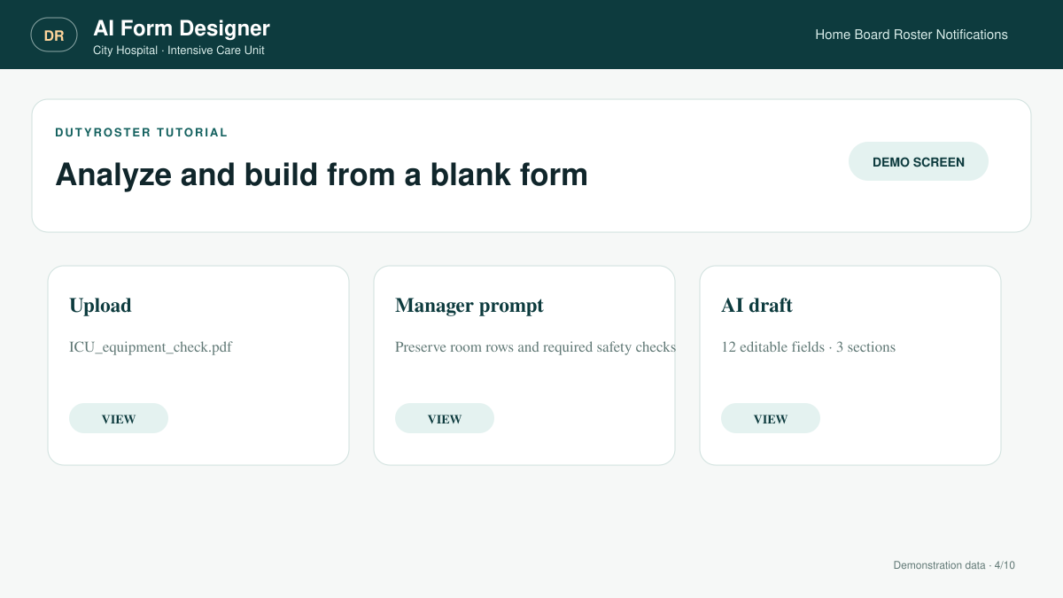
DUTYROSTER
05
AI FORM DESIGNER
Import a blank form with AI
Upload a clear blank image or PDF, then add instructions before AI prepares an editable draft.
Preserve sections, tables and choices
Choose frequency and repetition
Verify every field before saving
Notes:
[Sources]
- DutyRoster V43 application interface and project source (internal, accessed 2026-09-04)
[/Sources]

Slide 6
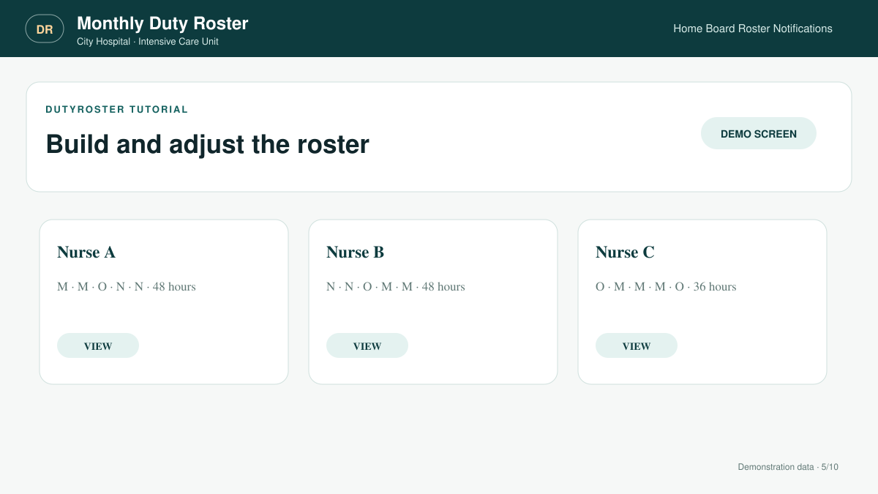
DUTYROSTER
06
FLEXIBLE SCHEDULING
Prepare the monthly roster
Combine staff requests, unit rules and manual control to create the monthly duty plan.
8-hour or 12-hour schedules
Registered and manual unit staff
Editable codes, columns and coverage totals
Notes:
[Sources]
- DutyRoster V43 application interface and project source (internal, accessed 2026-09-04)
[/Sources]

Slide 7
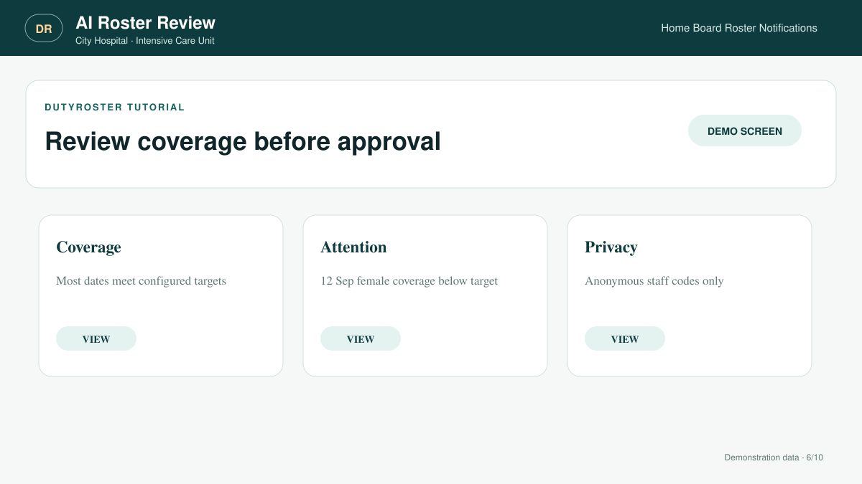
DUTYROSTER
07
DECISION SUPPORT
Review the draft with AI
Send an anonymized roster for a focused review before management approval.
Coverage and consecutive work
Night-to-Morning transitions
Fairness and obvious conflicts
Notes:
[Sources]
- DutyRoster V43 application interface and project source (internal, accessed 2026-09-04)
[/Sources]

Slide 8
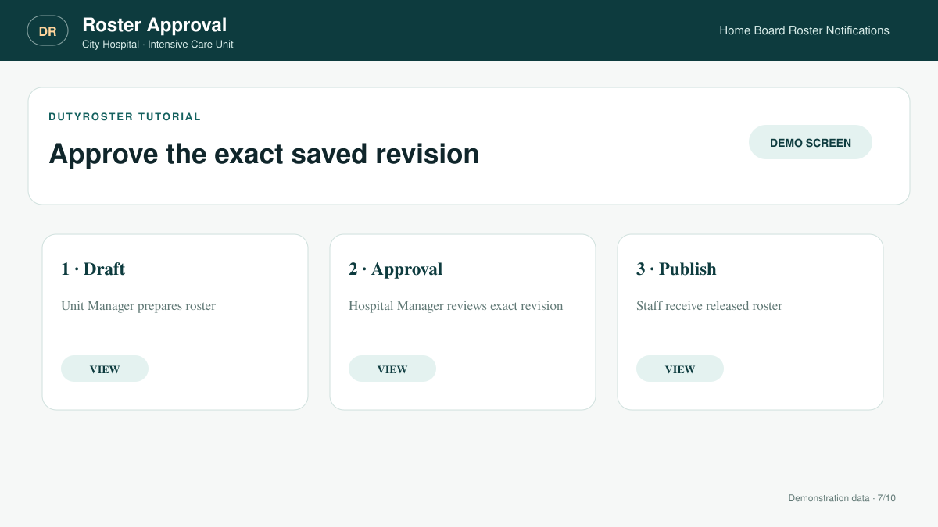
DUTYROSTER
08
MANAGEMENT WORKFLOW
Approve before publishing
A completed roster moves through controlled approval and staff release.
Unit Manager submits the month
Hospital Manager approves or returns it
Offline approval path when no account exists
Notes:
[Sources]
- DutyRoster V43 application interface and project source (internal, accessed 2026-09-04)
[/Sources]

Slide 9
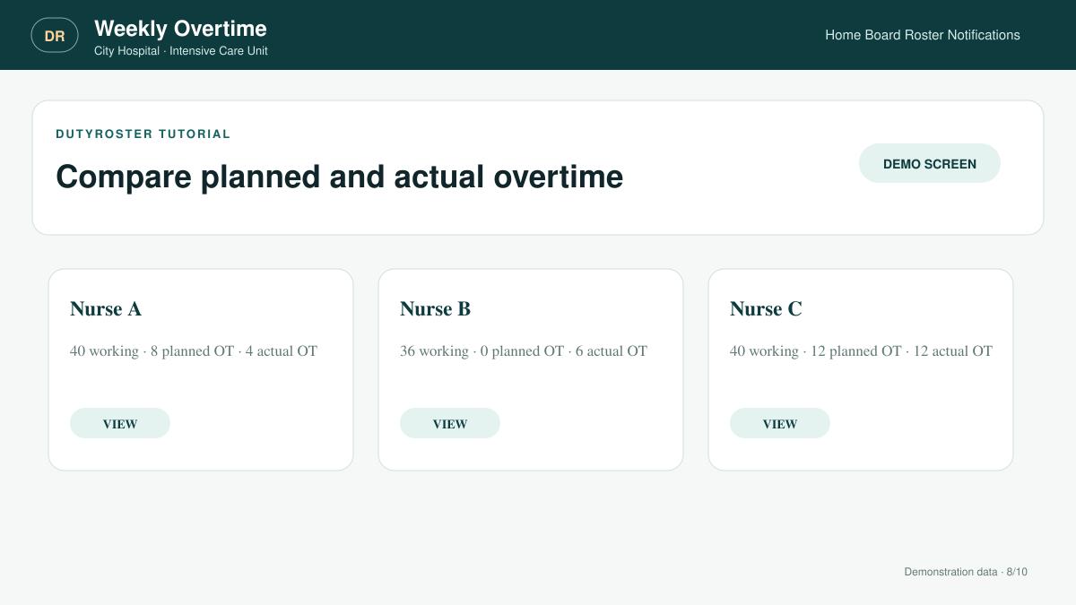
DUTYROSTER
09
SATURDAY TO FRIDAY
Compare weekly overtime
Calculate complete weeks even when the first or last week crosses into another month.
Planned versus actual hours
Editable weekly requirement
Staff-specific hour exceptions
Notes:
[Sources]
- DutyRoster V43 application interface and project source (internal, accessed 2026-09-04)
[/Sources]

Slide 10
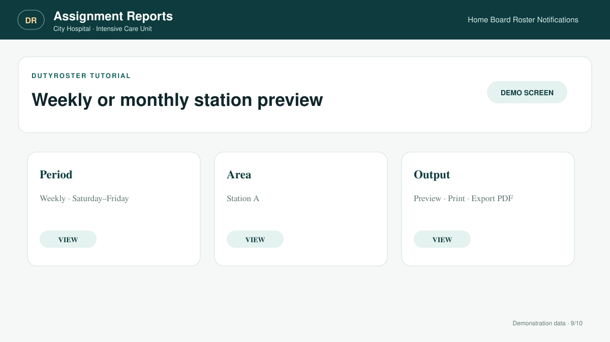
DUTYROSTER
10
WEEKLY AND MONTHLY REPORTS
Preview assignment periods
Select a period and station or area before sharing a clear operational report.
Weekly or monthly date range
One station or the full unit
Print or hospital-branded PDF
Notes:
[Sources]
- DutyRoster V43 application interface and project source (internal, accessed 2026-09-04)
[/Sources]

Slide 11
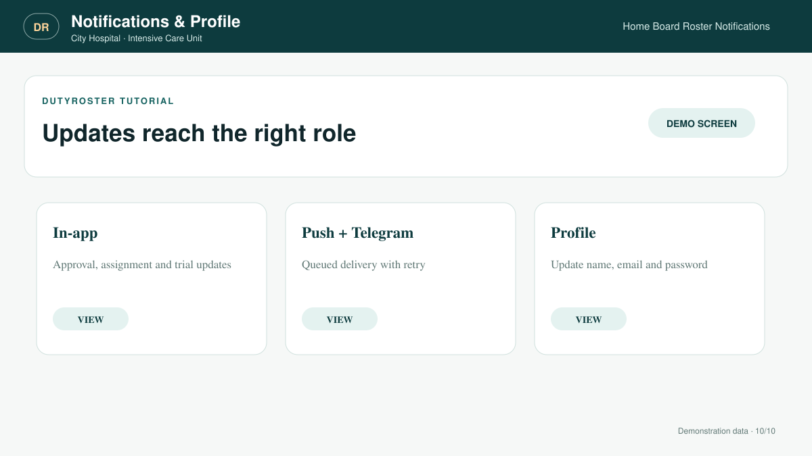
DUTYROSTER
11
PROFILES AND NOTIFICATIONS
Keep everyone informed
Use in-app, push and Telegram delivery while staff maintain their own account details.
Roster release and approval alerts
Queue-backed hybrid delivery
Edit name, email and password
Notes:
[Sources]
- DutyRoster V43 application interface and project source (internal, accessed 2026-09-04)
[/Sources]

